Slide 1



Rollout of Envision 2030:
Building Capacity &
Strengthening Innovation
December 18, 2020

Slide 2
Introduction & Welcome
Dr. Eugene T. W. Sanders
CEO & Superintendent

Slide 3
Introduction & Welcome
Mrs. Martha Murray
President, Board of Education

Slide 4
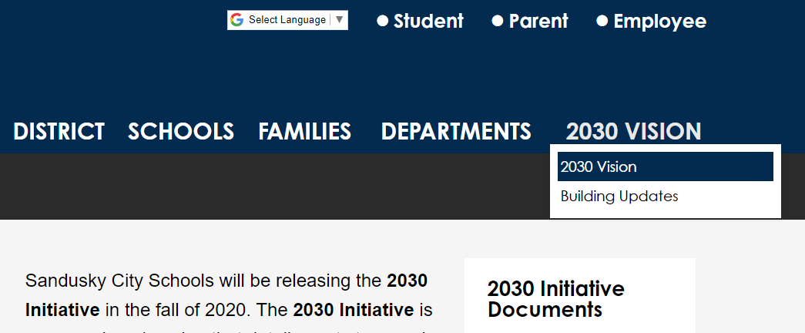
Where to Find this Presentation &
Related Documents
www.scs-k12.net/Transformation.aspx

Slide 5
Importance of Financial Planning
& Fiscal Visioning
Mr. Jeff Hall
Chief Financial Officer & Treasurer

Slide 6
Financial Forecast Summary
Revenue Surplus/Deficit & Cash Balances

Slide 7
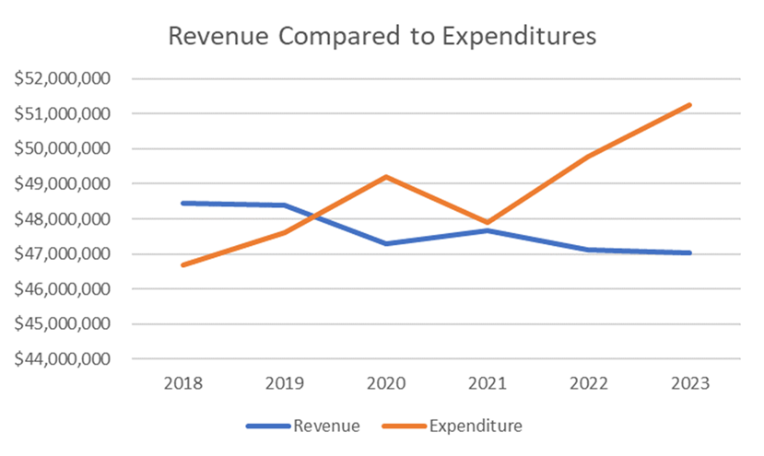

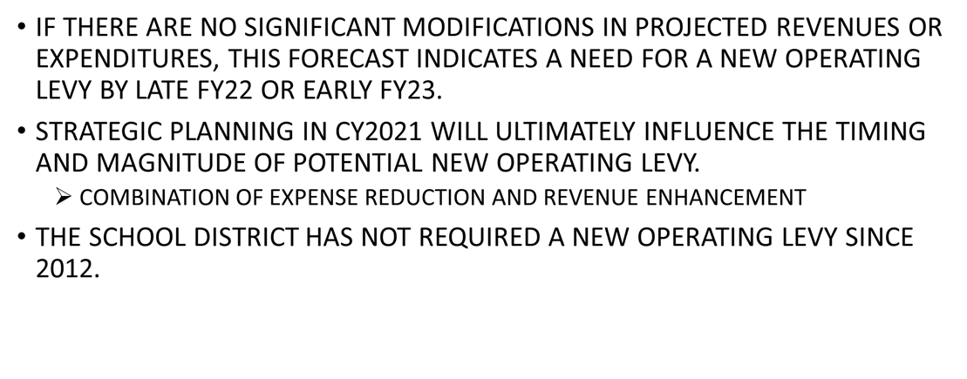
Financial Planning Implications

Slide 8
Purpose & Background for Providing Long-Range Planning
Dr. Eugene T. W. Sanders
CEO & Superintendent

Slide 9
Purpose & Background of Long-Range Planning
Managing the pandemic but providing a vision is essential to our success
Our commitment to students of today and the generations to come
Building on the success of the last 8 years
  Improved student performance
  Improved graduation rates
  Ushering in the Transformation Plan

Slide 10
Purpose & Background of Long-Range Planning
Delivering innovative programs and initiatives
  Blue Streak University (BSU)
  Global Internship Experience (GIE)
  Great Lakes Visual & Performing Arts Academy (GLVPAA)
  Regional Center for Advanced Academic Studies (RCAAS)
  Sandusky Digital Learning Center (SDLC)
  The 70 million dollar school facilities vision (Building Better Dreams)
  The Aquatic Center at Sandusky High School yet to come

Slide 11
Purpose & Background of Long-Range Planning
We can BUILD CAPACITY and CONTINUE our INNOVATION
TEAMWORK, VISION, and COMMITMENT is the key
We can achieve anything by working together

Slide 12
Organization & Structure
Dr. Stephen Sturgill
Chief of Staff & Transformation Officer

Slide 13
Why Envision 2030 is Important to SCS & the Community
It’s a transparent document that involves all stakeholders and concerned persons within the community
The plan addresses student support, academic achievement, mental and physical wellness, technological readiness, post-secondary school options, and health community connections
It is a strategic review of our innovative programs and determines the viability of each program and its effectiveness
To affirm that every Sandusky City Schools student has an unparalleled school experience

Slide 14
Why Envision 2030 is Important to SCS & the Community
To maintain a grade of “C” of higher on the ODE report card
To determine if the program’s goals are being met and to determine the program’s plan for long-range leadership
To ensure all SCS programs are relevant, competitive, cutting edge, and worthy of continuation
To determine if the results justify the invested time and labor to continue the program

Slide 15
What is in the 2030 Plan?
Section 1: a review of the 2030 program review initiative
Section 2: provides the goals of each of the innovative programs
Section 3: presents the model from which the standards of the 2030 Initiative are based; gives an overview of how it will serve to evaluate the progress of each program’s goals

Slide 16
Academic Framework, Goals,
& Anticipated Outcomes
Dr. Vilicia Cade
Chief Academic Officer

Slide 17
Our Academic Theory of Action
This informs adults behavior in our organization.
It is important that all SCS employees understand how their roles and responsibilities contribute to our students’ academic success.
Our Theory of Action keeps everyone’s efforts centered on the most important work—Increasing student achievement!

Slide 18
New Instructional Framework
Outgrowth of “The Collective Efficacy Project: Academic 5K”: we want our students to develop a level of “efficacy” or ownership of their learning.
Personalizing and customizing learning will be even more important Post-COVID because of COVID loss.
Undergirding competency-based learning is problem solving and project-based learning - more importantly, focusing on students mastering skills and content.
The learning environment will look different. New facilities and upgrades with existing space use will be critical to 21st Century learning.

Slide 19
Eight Guiderails for Our Journey……
Instructional staff function as instructional leaders
Vertically aligned districtwide Professional Development Plan
Advance a culture of collaborative data-driven decision making
Significant role of technology
Google certification, digital portfolios, and student-led conferences
Efficient information management
Project-based learning and emphasis on STEAM while strengthening post-secondary preparation
Voice and Choice

Slide 20
Creating Our Vision In Digital Times for Academic Transformation
Engaging our stakeholders:
A Profile of a Graduate of 2030
A Profile of a Teacher of 2030
A Profile of an Educational Leader of 2030
Our goals include vetting the skills, dispositions and knowledge needed to be successful
in competing in the global economy and
to meet success in the new educational environment.

Slide 21
Key Next Steps, Communication,
& Feedback
Dr. Eugene T. W. Sanders
CEO & Superintendent

